Slide 1
Playing Pong Using Multiple RL Algorithms
EN.705.741 Fall 2024
Kate Hornbeck and Alayna Stepp

Slide 2
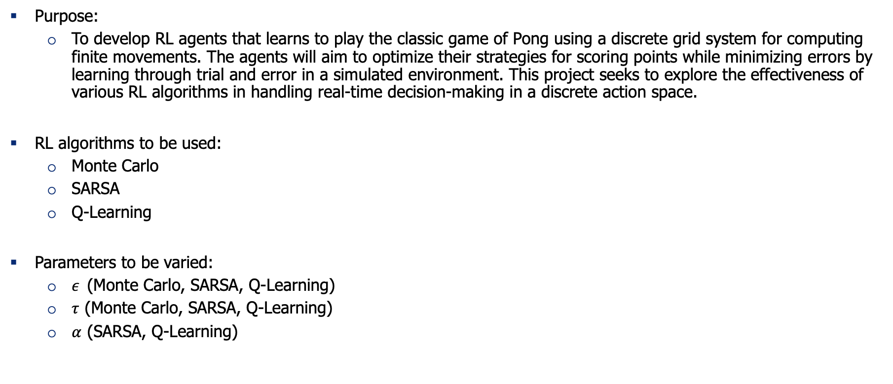
Project overview:
Purpose:
To develop RL agents that learns to play the classic game of Pong using a discrete grid system for computing finite movements. The agents will aim to optimize their strategies for scoring points while minimizing errors by learning through trial and error in a simulated environment. This project seeks to explore the effectiveness of various RL algorithms in handling real-time decision-making in a discrete action space.
RL algorithms to be used:
Monte Carlo
SARSA
Q-Learning
Parameters to be varied:
$ε$ (Monte Carlo, SARSA, Q-Learning)
$τ$ (Monte Carlo, SARSA, Q-Learning)
$α$ (SARSA, Q-Learning)

Slide 3
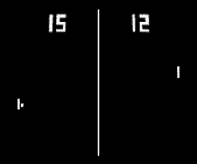
Environment
Two distinct training environments:
Static Opponent Environment: The agent competes against a wall that consistently returns the ball, creating a predictable training setup with minimal variability.
Dynamic Opponent Environment: The agent competes against another agent, introducing unpredictability and requiring the RL algorithms to adapt to dynamic strategies.
Key Features:
Agent Placement: Agents trained on either side (left or right) for symmetry and fairness.
State Space: 10x10 grid with x/y ball position, y paddle position, and ball velocity (dx/dy). Total: 9000 states, 810 terminal.
Randomized Starts: Ball’s y-position and velocity (dx/dy) randomized. Ball x-position fixed to avoid unfair placements near paddles.
1972 Atari Pong

Slide 4
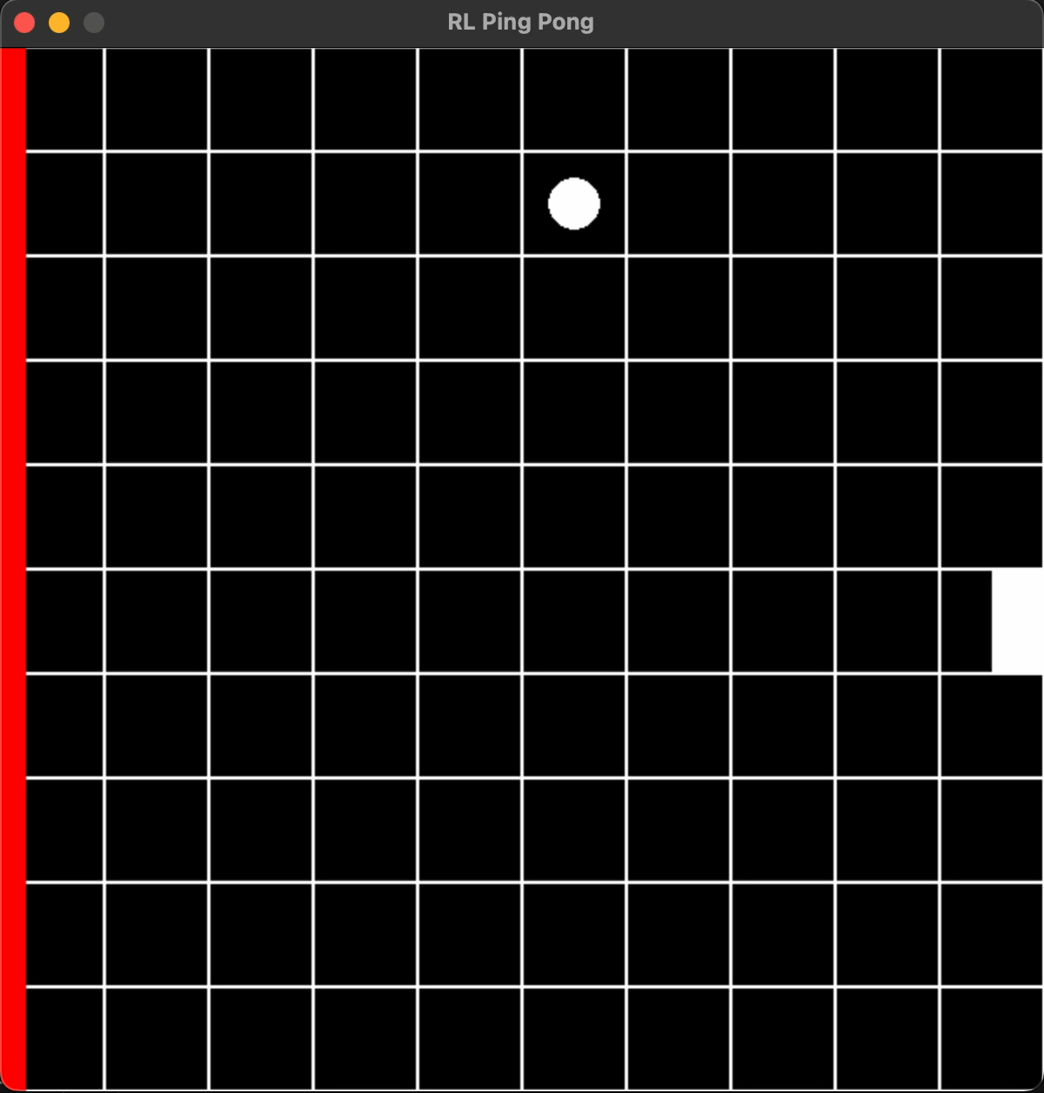
Methods: Parameters & Configuration
Flexible Experimentation: Configured via Python argparse library to allow control over algorithms, hyperparameters, and visualization.
Key Parameters:
--sarsa: Runs the SARSA algorithm.
--monte: Runs the Monte Carlo algorithm.
--qlearning: Runs the Q-learning algorithm.
--left /--right: Places the agent on the left or right paddle.
--plot: Generates reward plots over episodes.
--gamma: Sets the discount factor (γ).
--alpha: Sets the learning rate (α).
--epsilon: Sets the exploration rate (ε).
--save: Saves the agent’s Q-table for reuse.
--viz: Enables a visualization of gameplay.
Agent vs Wall Visualization via Pygame

Slide 5
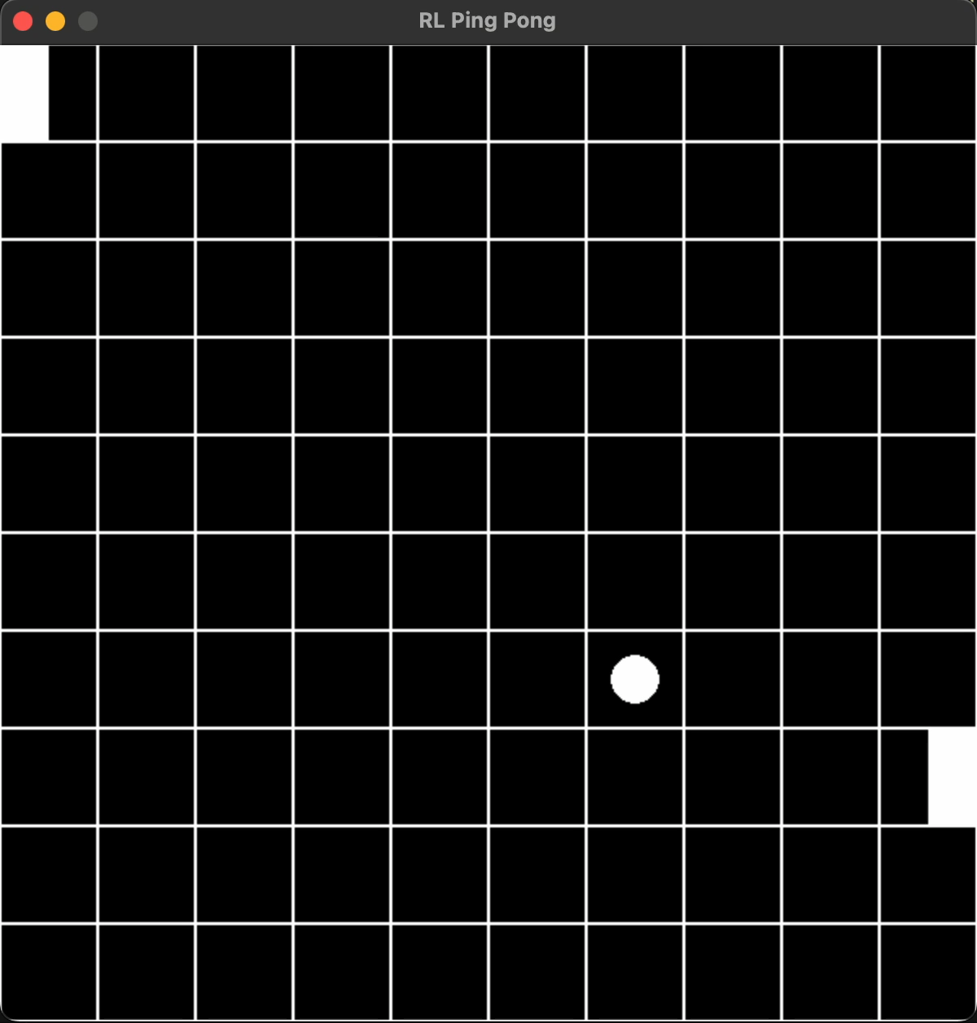
Methods: Agent Features & Training
Hyperparameter Tuning:
Key Variables:
--gamma (γ): Balances future vs. immediate rewards.
--alpha (α): Controls learning rate.
--epsilon (ε): Adjusts exploration-exploitation balance.
Grid search used to find optimal settings over 1000 episodes.
Training Setup:
1000 episodes, 1000 steps max per game.
Positive Reward: Ball not passing paddle.
Negative Reward: Ball passes paddle.
Win: If episode ended and agent had a positive reward, was counted as a victory.
Agent vs Agent Visualization via Pygame

Slide 6
Methods: Agent vs Agent
Evaluation Method: After tuning the hyperparameters and training each agent with their optimal parameters, we assessed their performance in an agent vs. agent environment.
Conditions: Pre-trained agents were loaded with the best parameter configurations from agent vs. wall training and were placed on the same side they were trained on to maintain consistency and optimal conditions during these matches.

Slide 7
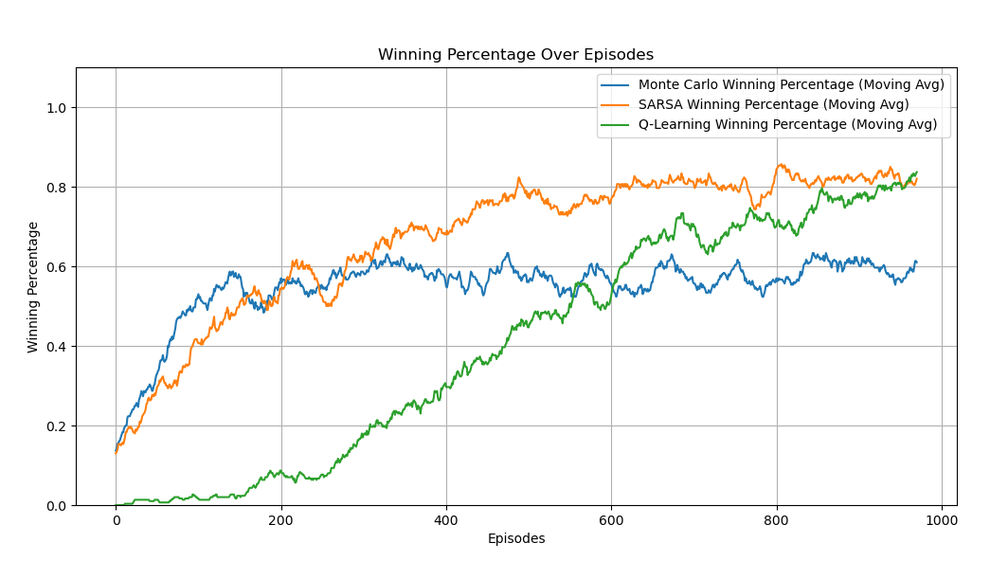
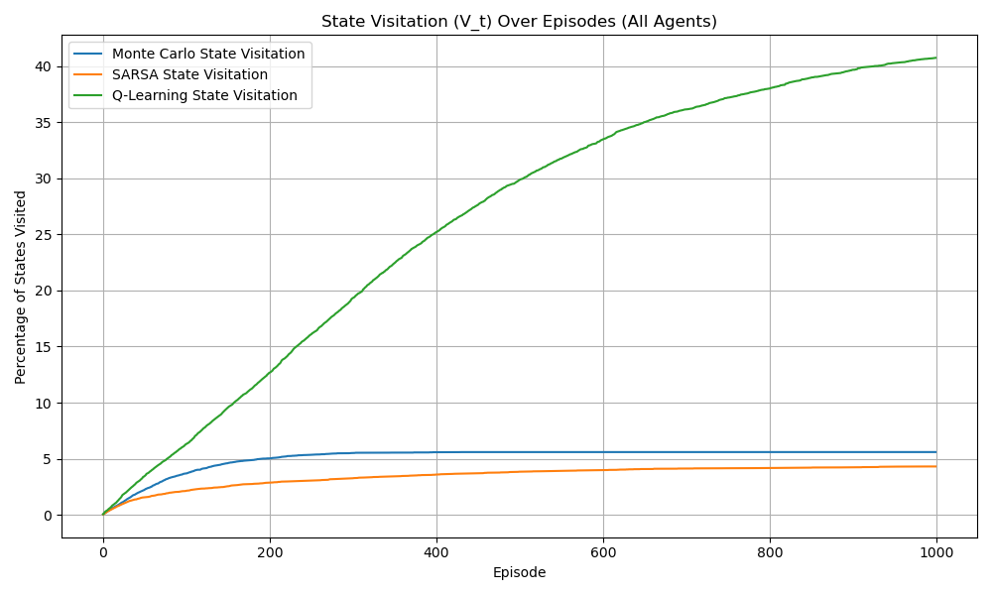
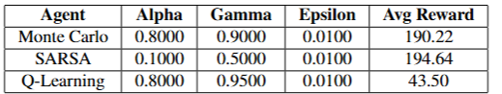
Results

Slide 8
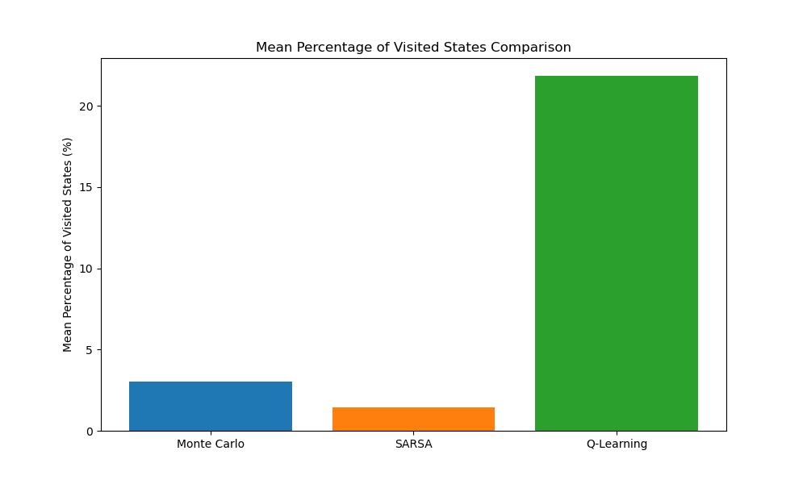
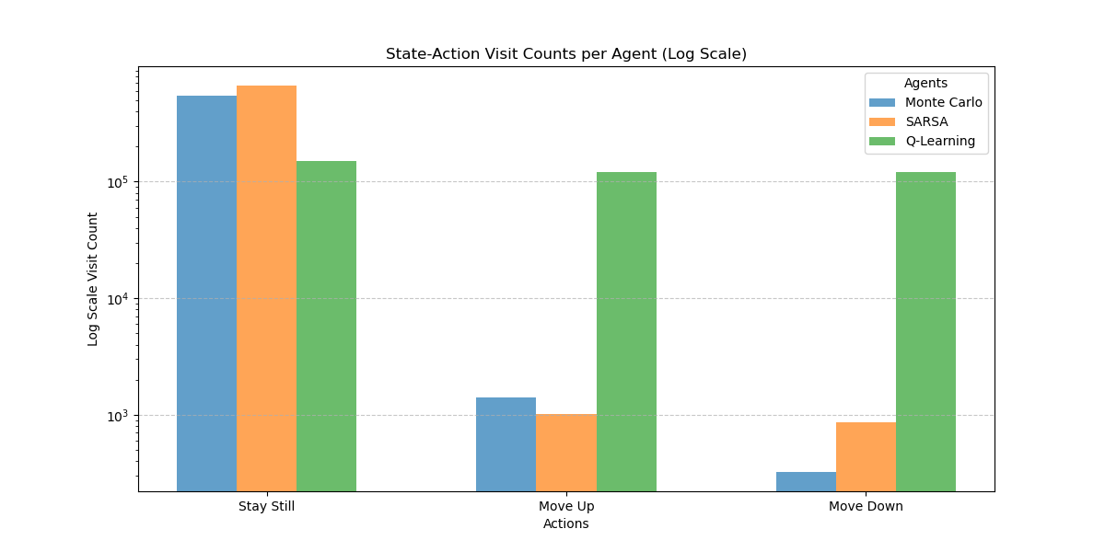
Results Cont.

Slide 9
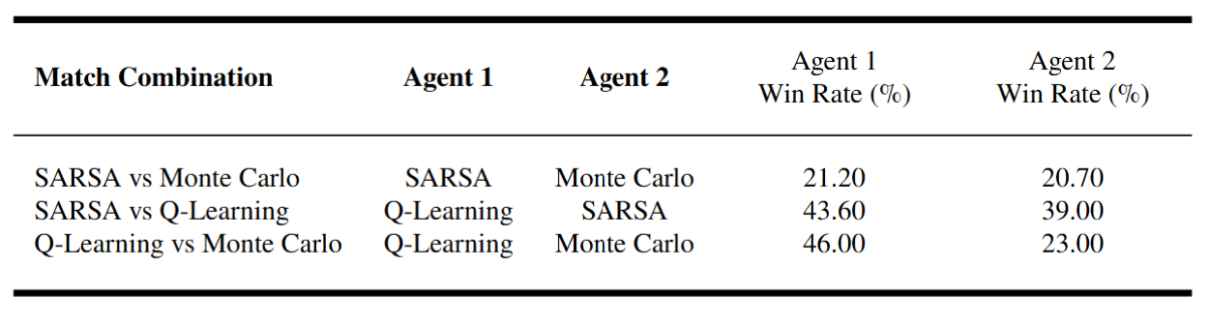
Results: Agent vs Agent

Slide 10
Future Research
Behavior identification
Comfort zones
Reward shaping
Curriculum learning

Slide 11
Conclusion
Q-Learning
shows the most potential for generalization
Exploration and continuous improvement
Monte Carlo and SARSA
High winning percentage but small state space
Limited adaptability

